Slide 1



1. V4 - Hungary
Visegrad spirit from the system changes to V4 foreign policy
2 371
The project is co-financed by the Governments of Czechia, Hungary, Poland and Slovakia through Visegrad Grants from International Visegrad Fund.
The mission of the fund is to advance ideas for sustainable regional cooperation in Central Europe.

Slide 2
Visegrad spirit
We have witnessed several paradigm changes in the last decades here in Europe and also globally. These changes also altered the way how we need to understand our world and the challenges stemming from these developments.
The importance of the Visegrad Cooperation, based on the principles guiding the V4 since its founding in 1991, namely mutual trust, flexibility, and a focus on common traditions, values and interests, has been growing recently. The V4 countries constitute stability and growth in the European Union, and have the legitimate intention to contribute substantially and as equal partners to the dialogue on the future of the EU, NATO and of course our region

Slide 3
New World Order?
Cornerstones of the last decades
Great power interests
New security threats and challanges
Geopolitical realities

Slide 4
The 2nd decade of the 21st century
Started pessimistically
Unpredictable and quick changes
Parallel new and old challanges
Fricitions within our alliance
Indentity crisis withtin the EU
  The old vs. new memberstates

Slide 5
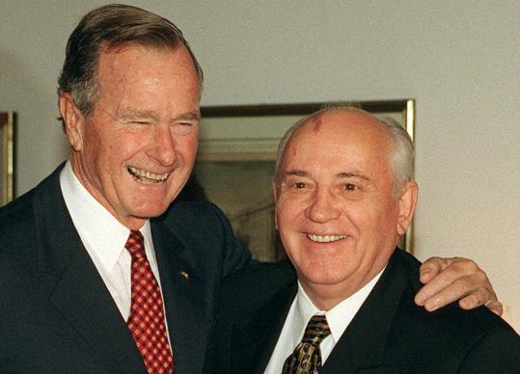
How did CEE get here?

Slide 6
Annus mirabilis
10 years, 10 months, 10 weeks, 10 days
Sinatra doctrine (Moscow pays more attention to the US)
Opening of the border in Hungary (Aug, 1989)

Slide 7
Hungary
1968. New Economic Mechanism
1980s – dual economy
1989 – parties are allowed
1989 reburial of Imre Nagy – birth of new generation of politicians
October 23, 1989 – Hungarian Republic
1990 (March and April) the first free parliamentary elections
New foreign policy strategy:
  Euroatlantic integration
  Friendly relations with the neighbours
  Protection the rights of Hungarian minorities living outside of the border

Slide 8
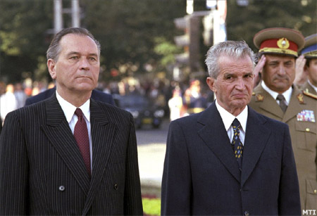

Slide 9
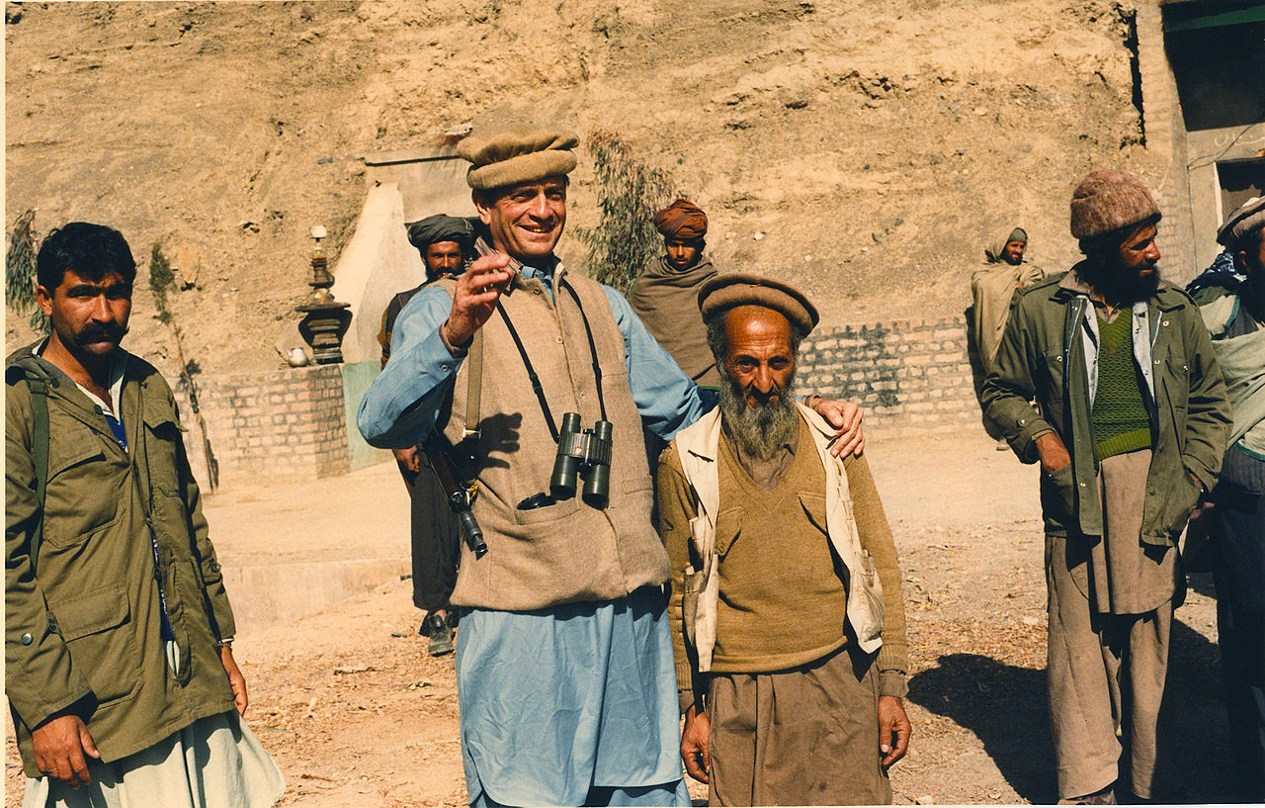
General developments
the difference between these revolutions and the annus mirabilis
  how the international environment reacted
  CCCP’s exhaustion after the Afghan war (see: Charlies Wilson’s war)
  US’ more active role in Eastern Europe
Gorbachev’s reforms:
  not just the regime , but also the people
  wanted changes
  Neither the Soviet army nor the police
  /law enformcement/KGB intervened

Slide 10
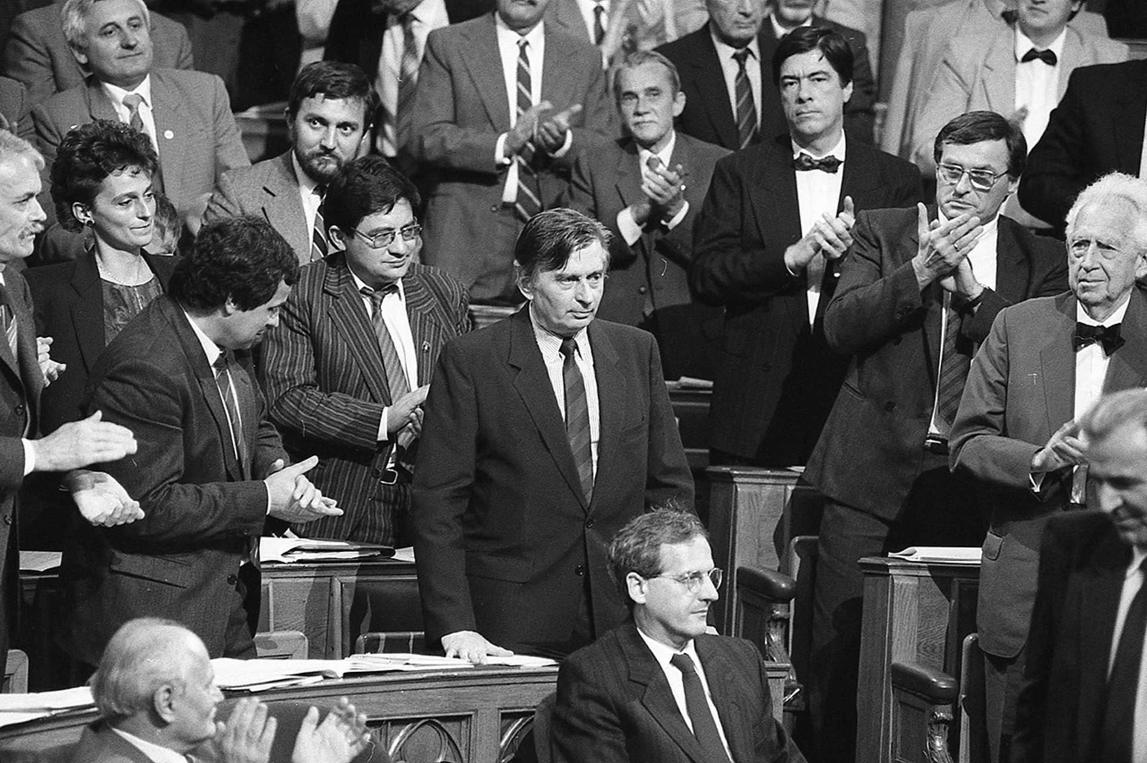
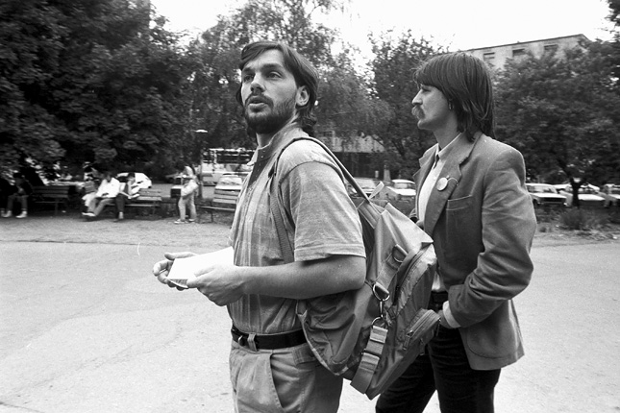
Hungary
National Roundtable discussion has been
formed by
  Opposition Round Table
  Communist Party
  trade unions
Opening the borders to Austria
  East-German citizens fled from GDR to Hungary first than to West-Germany through Austria
First elections:
  1990 Hungarian Democratic Forum (24.7%) (József Antall)
  Alliance of Free Democrats (21.4%),
  peasant party and socialists with 10-10%

Slide 11
The role of the European Union
The EU’s interest in enlargement
  In the 80s, the EU started to lose competitiveness and CEE would meant 100 million new customers
  It would also help global position of the EU comparing to the US, Japan, China etc.
Acquis communautaire
  Law approximation is the goal
  Pre-accession strategy of the Commission (1995)
  Institutional guarantees
Funds for economic modernization
  PHARE program
  CEE achieved less than 75% of the EU average in terms of GDP and there were huge regional disparities (Budapest and Prague area was relatively rich)
  EU funds were not used properly – corruption
  Unemployment in V4: EU fears of Eastern European mass migration
  Agenda 2000 reform of the EU agricultural and cohesion sector

Slide 12
Pre-accession
Flexibility is the strength of V4 cooperation format
Differing positions:
  Czech: V4 = minimalist, consultation body without any consistent and persistent content
  Hungarians: pragmatic approach, V4 cooperation is part of a process and not an entity in itself
  Poland: maximum expectations to regain great power position, V4 is a good platform for this long-term plan
  Slovak: essentialist, European identity is the goal, and V4 can help them on this road

Slide 13
Pre-accession
Czechs are more advanced, hence they walk their own path
Hungary and Slovakia: international legal dispute (Bős-Nagymaros)
Content of the Visegrad Cooperation document published in 1999
  How V4 2.0 shall look like
  Information transfer regarding NATO affairs – help Slovakia
  Priorities: justice and home affairs (illegal migration, drug trafficking, arms dealers), culture exchange programs, education
Structure:
  Annual PM summit
  Foreign minister’s summit in each semester and other ad hoc ministerial meetings
Štiřín summit:
  establishment of International Visegrad Fund (8 million euros per year in 2020)
  V4+ framework

Slide 14
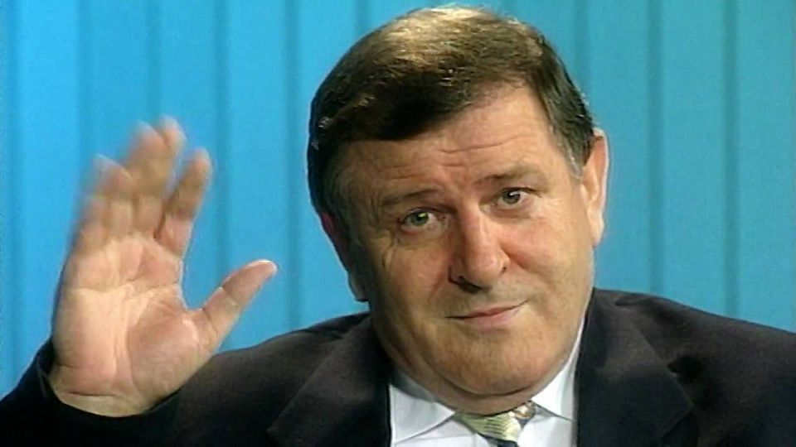
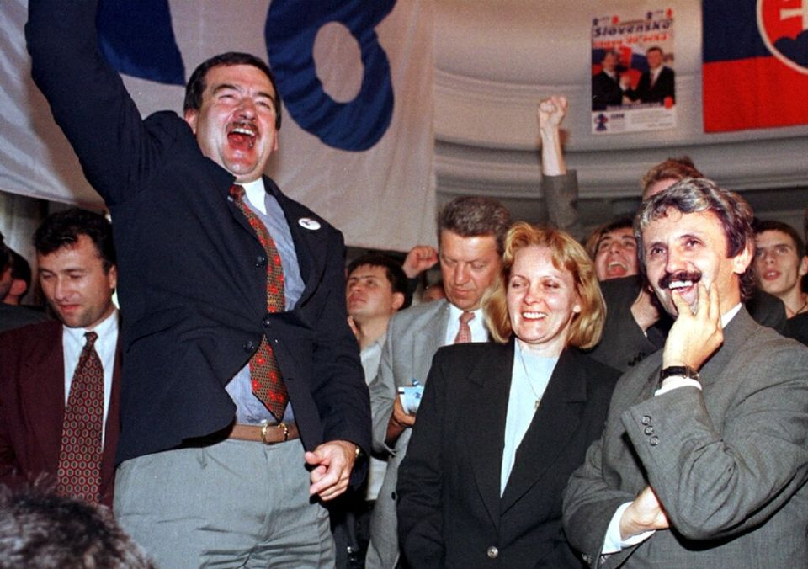
Pre-accession
V3 joined NATO
Slovakia:
  democratic values and Meciar government
  Dzurinda wins the elections in 1998

Slide 15
Copenhagen criteria
Democracy, rule of law, human right, minority protection,
Functioning market economy, capability to compete within the domestic markets of the EU
EU acquis, regulations to incorporate in domestic legal system

Slide 16
Referendum on EU accession
Country | Application | Date of the referendum | Participation | Supporting EU accession(%)
Czech Republic | 17 January 1996 | 13-14 June 2003 | 55.21 % | 77.33 %
Hungary | 31 March 1994 | 12 April 2003 | 45.62 % | 83.76 %
Poland | 5 April 1994 | 7-8 June 2003 | 58.85 % | 77.45 %
Slovakia | 27 June 1995 | 16-17 May 2003 | 52.15 % | 92.46 %

Slide 17
Public support of EU accession
Hungary:
  Fidesz government supported EU accession
  MDF and KDNP has been cautious and referred to sovereignty problems
  No participating threshold
Czech Republic
  Government supported
  ODS supported on behalf of the opposition
  Vaclav Klaus was Eurosceptic and have been elected president
Slovakia:
  Participating threshold, but 90%+ yes vote
Poland:
  Self-defence and Polish Families League: against
  Participating threshold, 75%+ yes vote

Slide 18
What is the V4 common position in EU?
Mutual respect – no pressure on sovereign states
Four freedoms and traditional EU policies to preserve
Further reforms on areas, which have true added values (like digitization, defence etc.)
Enhance cooperation, if necessary: multi-level EU
Respect towards Constitutional values

Slide 19
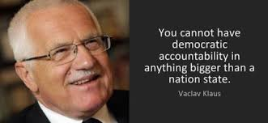
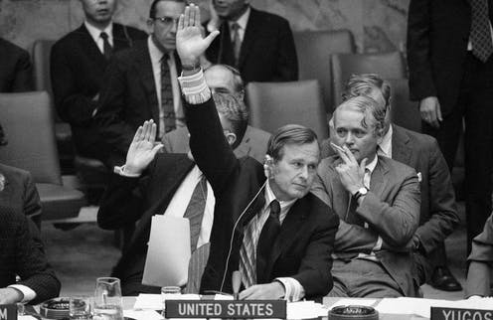
Early stages of NATO accession
Vaclav Klaus:
  Pentagonal format to be preferred
George Bush sen. (1990)
  Open door policy
  V4 needs to work together
  to prove their capabilities
    To cooperate
    To match NATo standards and share common values

Slide 20
Early stage
Visit of PM Hanna Suchocka (PL) (1992)
  Gen. Manfred Wörner becomes NATO Sec. General
  Meeting with Suhocka: PL will be amoing first to join
PM József Antall (HU) (1993)
  Informed NATO SG about the willingness to join NATO
North-atlantic Cooperation Council (NACC)
  Established a diplomatic platform for negotations
  Successor: Partnership for Peace Programme

Slide 21
PfP
Enlargement as toolbox to prevent nationalism
  See: Asmus-Larrabee-Kugler (1993) article for RAND
John F. Kennan:
  Russia is still an important factor
  Remain vigilant
Germany
  to convince European partners to support Eastern enlargement
US
  Step-by-step approach, to advance gradually, PfP at first, membership at second
  1994: informed V4 leaders about the requirements

Slide 22
Hungary
Preparation since 1993 to sign an IPP
Legal and regulatory environment to be built until 1997
Learn from the joint British_hungarian military exercise
  Common language is key
Cooperative Bridge-94 exercise
  HU decided to reamin absent because of financial struggles

Slide 23
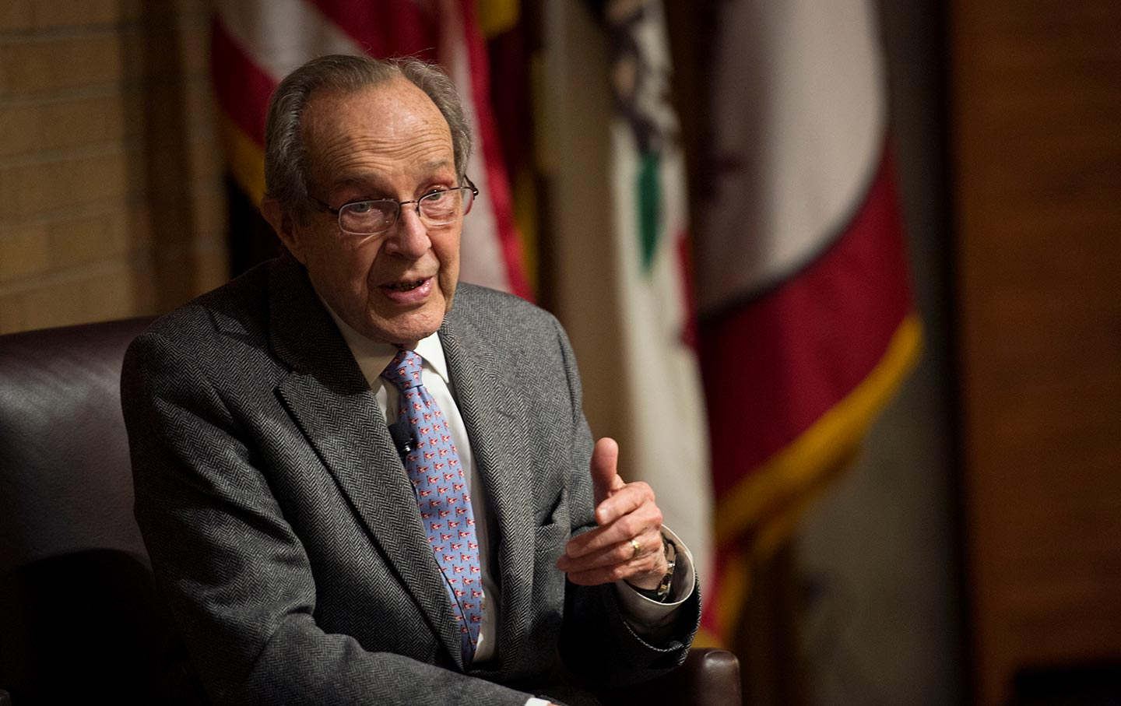
Accession talks
William Parry:
  Parry-principles
Madrid Summit (1997)
  V4 countries invitation to NATO
  Slovakia and Romania – too soon
  But no harm for other V4 countries, because of SK – decision to go forward
NATO-Russia Permanent Council
  Goal is to maintain dialogue with Russia, a partner country of NATO

Slide 24
Accession talks
Brussels (1997)
  Accession document signed by 16 members of NATo
  Ratification in the next year
29 January 1999
  Javier Solana announces the results
12 March 1999
  meeting with Madelaine Albrigth in Independence (Missouri)

Slide 25
Challenges
Decision-making and implementation:
  De facto control of process from joint staff to MoD
  Military type ministries transformed into civilian
  Know-how
Evaluation mechanisms and reporting
Budget control

Slide 26
V4 Summits
Document called: Content of the V4 cooperation (1999)
MoD Summit in Premysl (1999)
Declaration about post-EU accession era cooperation of the V4 Group countries (2004)

Slide 27
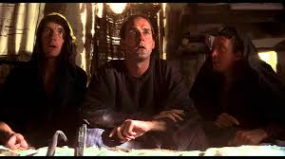
What has the US ever done for us?

Slide 28
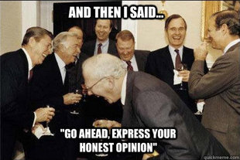
US support in the Euroatlantic integration

Slide 29
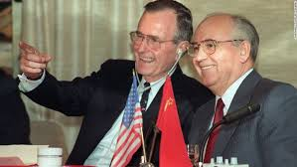
Bush administration
Europe whole and free
Chicken Kiev
Remained in Europe
Empire by invitation
Goodwill hegemon

Slide 30
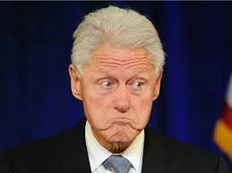
Clinton administration
PfP
NATO enlargement
Soft power
Economic dominance
Kosovo

Slide 31
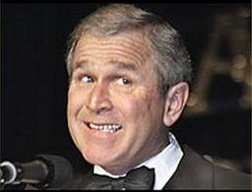
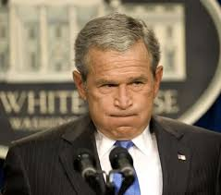
Bush administration
Coalition of the willing
Missile defense
NATO Bucharest Summit

Slide 32
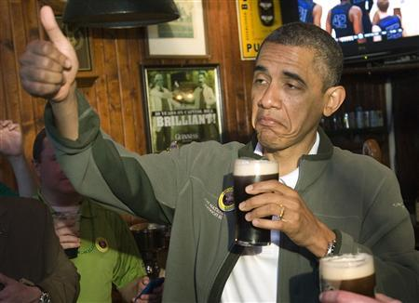
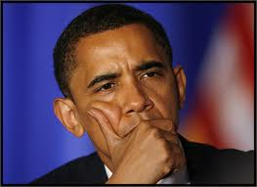
Obama Administration
Reset
  Prague Meeting
Missile defense
Liberal-idealist value package
But realist
Incoherent

Slide 33
Trump administration
2019 is a historic benchmark
  30-20-15
Come back to Europe?
Trump and the NATO
Helsinki
Division in Europe
Three Seas Initiative

