Slide 1
Political system in the countries in the Visegrad Group
PhD Ewelina Kancik-Kołtun

Slide 2
A little history of V4
The Visegrad Group was formed in February 1991 in Visegrád, Hungary, as a political alliance of three CEE leaders and friends – Lech Wałęsa, Václav Havel and József Antall – with the aim of coordinating the process of post-communist transformation often described as “a joint return to Europe”. After the January 1993 “velvet divorce” between Czechs and Slovaks, the V3 became V4 – now consisting of Hungary, Poland end the Czech and Slovak Republic – though the overall form and aims of the Alliance remained unchanged.

Slide 3
The formation of the Visegrad Group was motivated by four factors of decisive relevance:
the desire to eliminate the remnants of the communist bloc in Central Europe;
the desire to overcome historic animosities between Central European countries;
the belief that through joint efforts it will be easier to achieve the set goals, i.e. to successfully accomplish social transformation and join in the European integration process; and
the proximity of ideas of the then ruling political elites. (Visegrad Group 2021)

Slide 4
Transformation
After 1989, the Central European countries were faced with the task of transforming their political systems into democratic ones. The political and socio-economic transformation in newly established democratic countries resulted in the introduction of new administrative and political solutions, as well as – at a later date (1 January 1993) – in a division of Czechoslovakia into two countries: the Czech Republic and Slovakia

Slide 5
Systemic changes
Systemic changes, including a shift from the oneparty system, the introduction of the multi-party democratic system, crystallization and transformation of the political scene, party systems and the creation of a new socioeconomic system have become a sign of the collapse of real socialism. An important aspect was also the issue of reorientation in the foreign policy of the countries in the discussed region, i.e. the dissolution of international organizations bringing together the socialist type of the Warsaw Pact or the Council for Mutual Economic Assistance and turning to the North Atlantic Pact (NATO), and the European Union institutions

Slide 6
Political party
A political party should be defined as a voluntary organization participating in free competition around the implementation of substantive objectives and filling state positions by gaining electoral support and legitimization for preferred political ventures, and thus gaining and maintaining state power [Wojtaszczyk 1998: 9]

Slide 7
The parties fulfill a number of functions in the democratic system, which include: the function of articulation and aggregation of interests, the function of mobility and socialization of citizens, the function of reconstructing political elites, the function of participation in the policies of the state, the autonomous function of the party

Slide 8
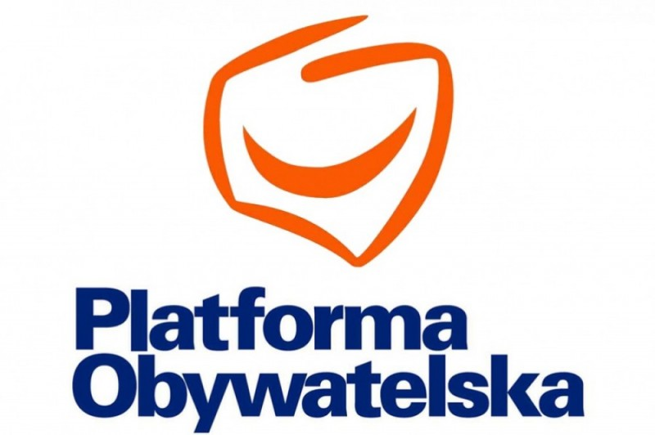
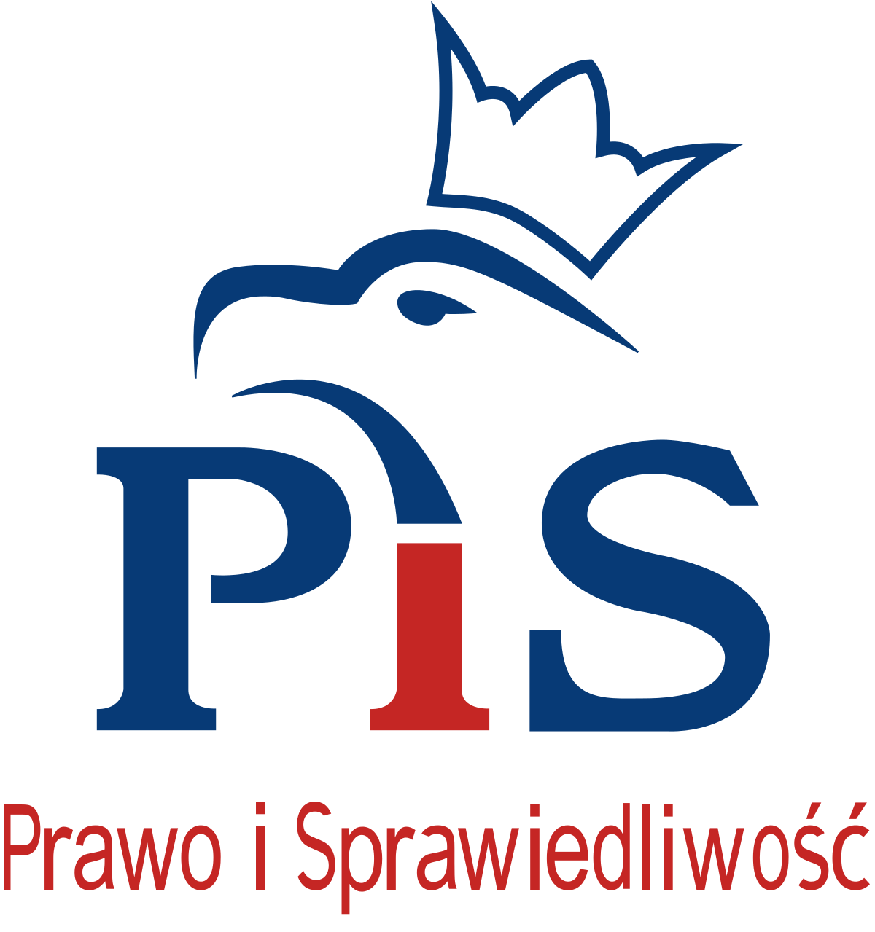
Poland
The Polish political scene is currently dominated by two party formations derived from the same Solidarity camp – Law and Justice (PiS) and Civic Platform (PO), which started its operations from similar political demands

Slide 9
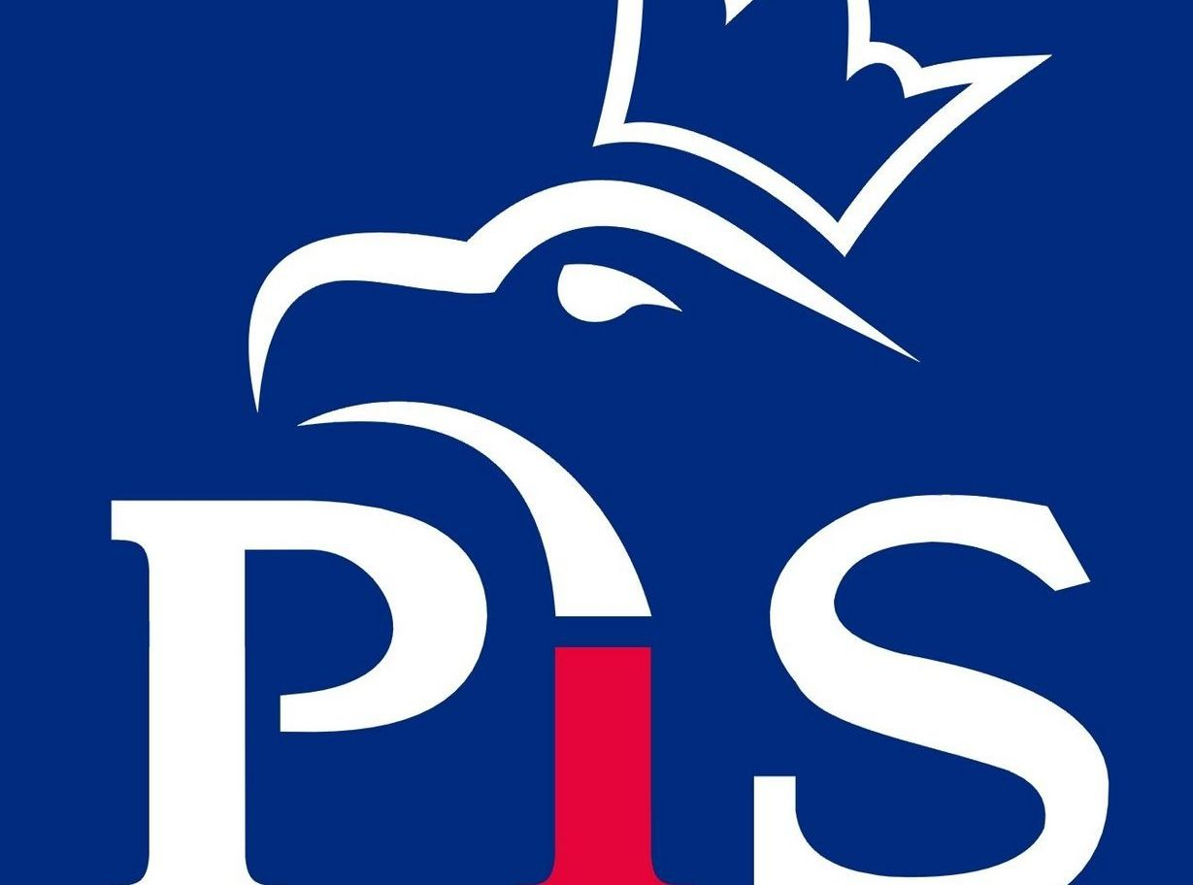
Law and Justice (Prawo i Sprawiedliwość, PiS)
Law and Justice was established in June 2001 and belongs to the group of parties with a right-wing political and economic program [Jartyś and Brudziński 2004: 33]. The creation of PiS was related to the consolidation of part of the right-wing circles of solidarity around the person of Lech Kaczyński – the Justice Minister in the government of Jerzy Buzek.

Slide 10
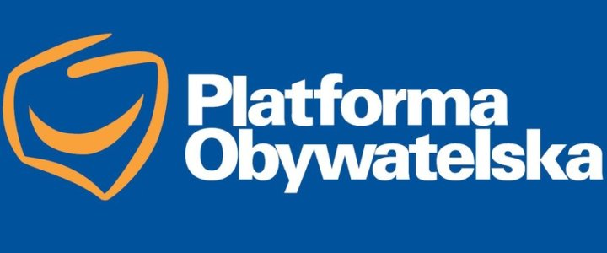
Civic Platform (Platforma Obywatelska, PO)
Civic Platform as a political group was established in January 2001, when internal problems in the ruling coalition forces – the Freedom Union and the Solidarity Electoral Action – occurred [Tomczak 2004: 15]. The core of the Platform were the activists of these two political parties. The co-creators of the formation, which at the beginning was focused on the elections and not on the creating a party structure, were Andrzej Olechowski, Donald Tusk, and Maciej Płażyński [Tomczak 2004: 15].

Slide 11
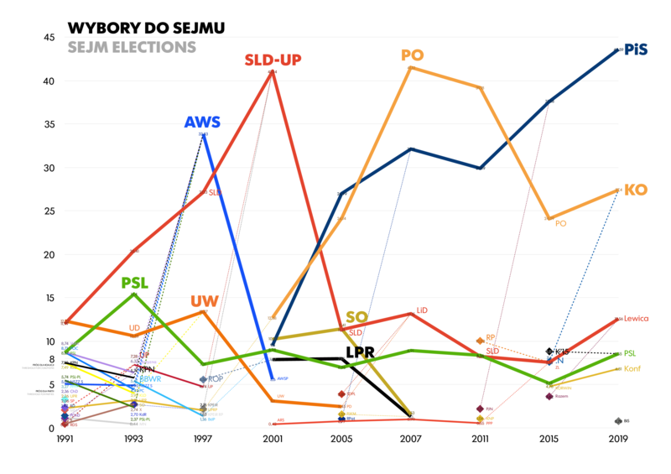

Slide 12
Parliamentary elections in Poland in 2019
Parliamentary elections to the Sejm and Senate in Poland in 2019 were held on October 13

Slide 13
Parliamentary elections in Poland in 2019
Party | Percentage of votes | Numer of seats | Percentage of seats
Prawo i Sprawiedliwość | 43,59 | 235 | 51,09
KKW Koalicja Obywatelska PO .N iPL Zieloni | 27,40 | 134 | 29,13
Sojusz Lewicy Demokratycznej | 12,56 | 49 | 10,65
Polskie Stronnictwo Ludowe | 8,55 | 30 | 6,52
Konfederacja Wolność i Niepodległość | 6,81 | 11 | 2,39
KWW Mniejszość Niemiecka | 0,17 | 1 | 0,22

Slide 14
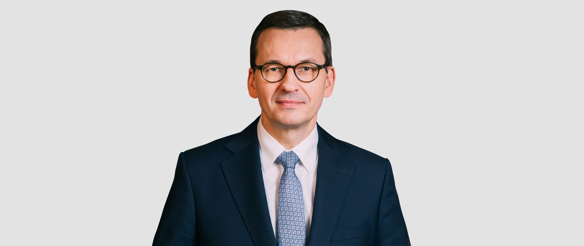
Prime Minister
Mateusz Morawicki (11.12.2017-now)

Slide 15


Czech Republic
The 2020 elections to the Senate of the Czech Republic were held on October 2 and 3, 2020 (first round) and on October 9 and 10, 2020 (second round), in accordance with President Miloš Zeman's decision of April 9, 2020. 27 senators were elected for a six-year term, thus renewing 1/3 of the Senate.

Slide 16
Czech Republic
The Czech political party system has been subject to change, and has developed gradually over the years since 1989. As it is impracticable to capture the full characteristics of this system by analysing its configuration at any given time, it is helpful to split its evolution into various phases (see below) [Bureš et al. 2012: 231; cf. Fiala and Hloušek 2003: 13]

Slide 17
The Czech political system
The operating units in the system, then, are political parties and movements, whose existence and activities are defined by the constitution and special legislation. The Czech political system is an instance of what Sartori defined as party-controlled parliamentarianism, where the executive is controlled through a parliament and the political system is based on competition between internally disciplined and stable political parties [Hloušek 2005: 438].

Slide 18
ANO
The main defining features of ANO 2011 are the following:
It was established as a specific elite party of a managerial and marketing type;
It is sometimes described as an entrepreneurial party, i.e. a business-firm party, but its organization is still being built up and the contours are not always clear;
There are no evident links with non-transparent business practices at the moment, however, there already have been some scandals
Babiš’s unique combination of political, economic and media power could potentially develop into oligarchism and authoritarianism [cf. Klíma 2015: 312

Slide 19
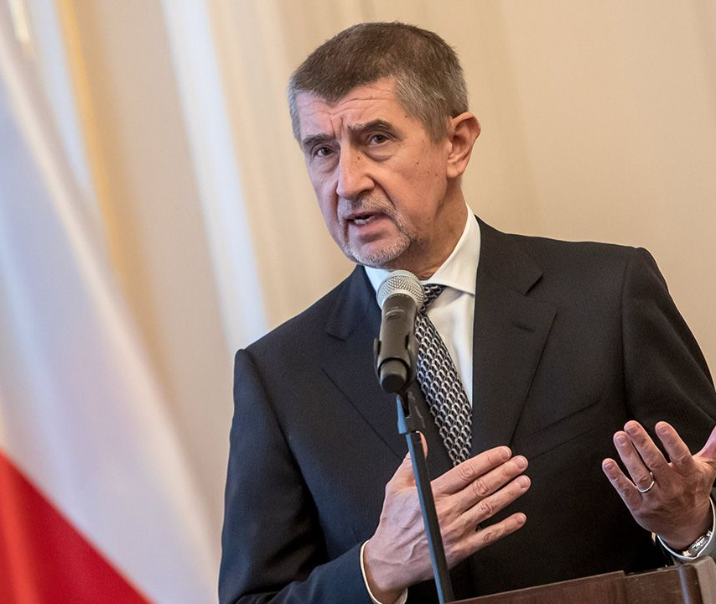
Prime Minister
Andrej Babiš (13.XII.2017-now)

Slide 20
Party system in Slovakia
Slovakia belongs to a group of post-communist countries and shares the features of their party system, including fragmentation, high volatility, instability and low prominence of socio-economic cleavages. Slovak post-communist party system has developed on the basis of several political cleavages – attitudes towards the communist regime, Mečiarism and anti-Mečiarism and EuroAtlantic orientation of the country [Kovanič 2018 ].

Slide 21
Slovakia
Parliamentary elections in Slovakia in 2020 - elections to the National Council, which took place on February 29. 24 election committees took part in the elections.
The elections to the National Council of the Slovak Republic were won by the Ordinary People party. SMER, We Are Family, Our Slovakia People's Party, SaS and For People also got to the National Council.

Slide 22
Parliamentary elections in Slovakia in 2020
Party |  | Vote | Seats
OĽaNO | 721 166 | 25,02 | 53
Smer-SD | 527 172 | 18,29 | 38
Sme Rodina | 237 531 | 8,24 | 17
ĽSNS | 229 660 | 7,97 | 17
SaS | 179 246 | 6,22 | 13
Dla Ludzi | 166 325 | 5,77 | 12
 | 2 916 840 |  | 150

Slide 23

Ordinary People and Independent Personalities (Slovak: Obyčajní ľudia a nezávislé osobnosti, OĽaNO),

Slide 24
OĽaNO
Establishing the party was based on the initiation of Robert Fico and Ján Slota to join their parties at that time and form an alliance majority. Consequently, their act was reflected in creating citizens’ initiative transforming into the citizens’ alliance “Ordinary People” (OĽaNO) focusing on limiting the power of politicians, fighting nepotism and corruption, led by Igor Matovič. The initiative transformed into a referendum held under the name “Po prstoch politikom” (“To watch politicians closely”). The referendum should have consisted of ten questions on the combatting corruption, but in fact it was not held [ Petriková, Dvorský 2018]

Slide 25
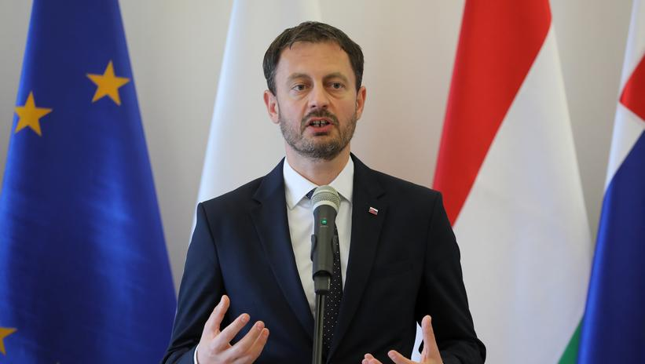
Prime Minister
Eduard Heger (21.IV.2021-now)

Slide 26
Hungary
Politics of Hungary takes place in a framework of a parliamentary representative democratic republic. The Prime Minister is the head of government of a pluriform multi-party system, while the President is the head of state and holds a largely ceremonial position. Executive power is exercised by the government. Legislative power is vested in both the government and the parliament. The party system since the last elections is dominated by the conservative Fidesz. The two larger oppositions are Hungarian Socialist Party (MSZP) and Jobbik; there are also opposition parties with no formal faction but representation in the parliament. The Judiciary is independent of the executive and the legislature [Fekete:2018]

Slide 27
The outcome of the Hungarian parliamentary elections (2018)
Party | % votes | Seats
Fidesz–KDNP | 49,27 | 133
Jobbik – Movement for a Better Hungary | 19,06 | 26
Hungarian Socialist Party– Dialogue for Hungary | 11,91 | 20
Politics Can Be Different 4 | 7,06 | 8
Democratic Coalition | 5,38 | 9
Together | 0,66 | 1
National Self-Government of Germans in Hungary | 0,46 | 1

Slide 28

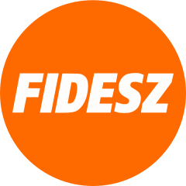
Fidesz-KDNP

Slide 29
Fidesz
Fidesz’s position on the political spectrum has changed over time. At its inception as a student movement in the late1980s, the party supported social and economic liberalism and European integration. As the Hungarian political landscape crystallized following the fall of communism and the first free elections, Fidesz began moving to the right. Although Fidesz was in opposition to the Hungarian Democratic Forum’s national-conservative coalition government from 1990 to 1994, by 1998 Fidesz was the most prominent conservative political force in Hungary.

Slide 30
Fidesz is currently considered a national conservative party favoring interventionist policies on economic issues like handling of banks, and a strong conservative stance on social issues and European integration [Rajcsányi 2012]. Like the Hungarian right in general, it has been more skeptical of the neoliberal economic policies than the Hungarian left: according to researchers, the elites of the Hungarian left (MSZP and SZDSZ) have been differentiated from the right by being more supportive of the classical liberal economic policies, while the right (especially extreme right) has advocated more interventionist policies. In contrast, on issues like church and state and family policies, the liberals show alignment along the traditional leftright spectrum [Todosijević 2004: 421]. Fidesz has adopted anti-immigration stances and rhetoric [Frayer 2015; Mortimer 2016; Nolan 2015]. Recently, the party has increasingly been described as far-right [Schaeffer 2017; Dunai 2017a; Huetlin 2018].

Slide 31
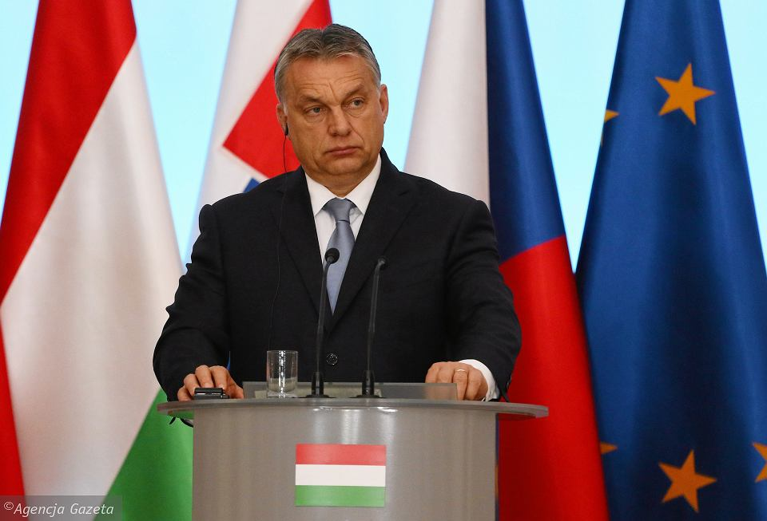
Prime Minister
Viktor Orbán (29.V.2010-now)

Slide 32
Literature
E. Kancik-Kołtun (ed), Contemporary Political Parties and Party Systems in the Visegrad Group Countries, Lublin 2018.

Slide 33
Thank you for your attention!

