Slide 1
Visegrad Four in the EU
Dr. Martin Hrabálek

Slide 2
The very beginning
Entry into the EU one of the reasons to establish V4
Another reaon was joining NATO
The cooperation had its ups and downs in 1990s

Slide 3
Slovaks not joining NATO in 1999
Czechia, Hungary and Poland joined in March 1999
Slovakia did not join at that time
Support from the other states of the region to access

Slide 4
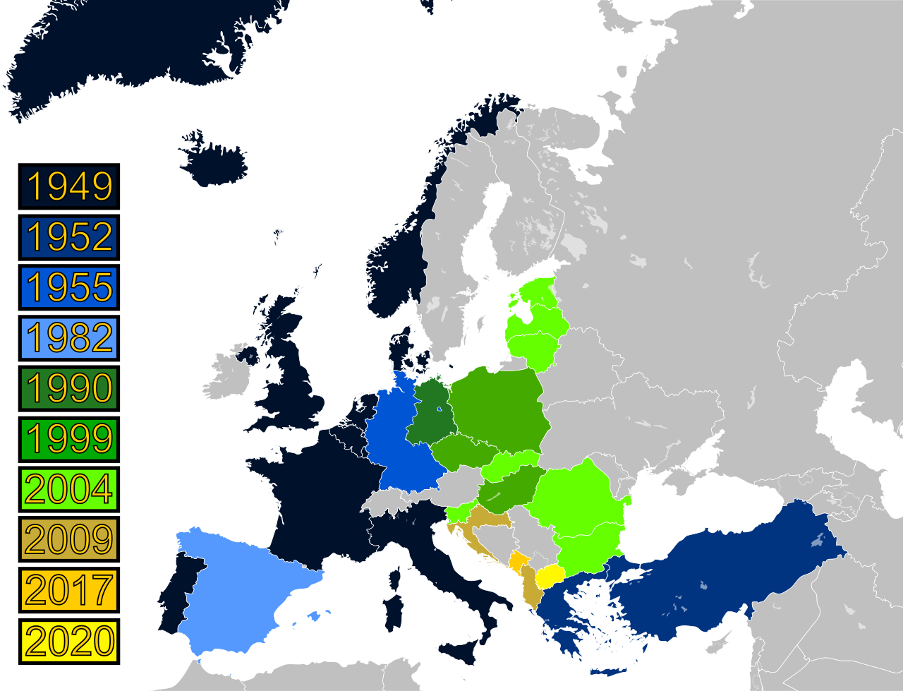
NATO Enlargement

Slide 5
EU accession
All states joined EU in 2004, together with other six states
Prior to 2004 concerted steps to join together
Different level of development
Need to fulfil the Copenhagen criteria – road to the EU
After the accesion the cooperation played a minor role
Visegrad would not be seen as significant actor

Slide 6
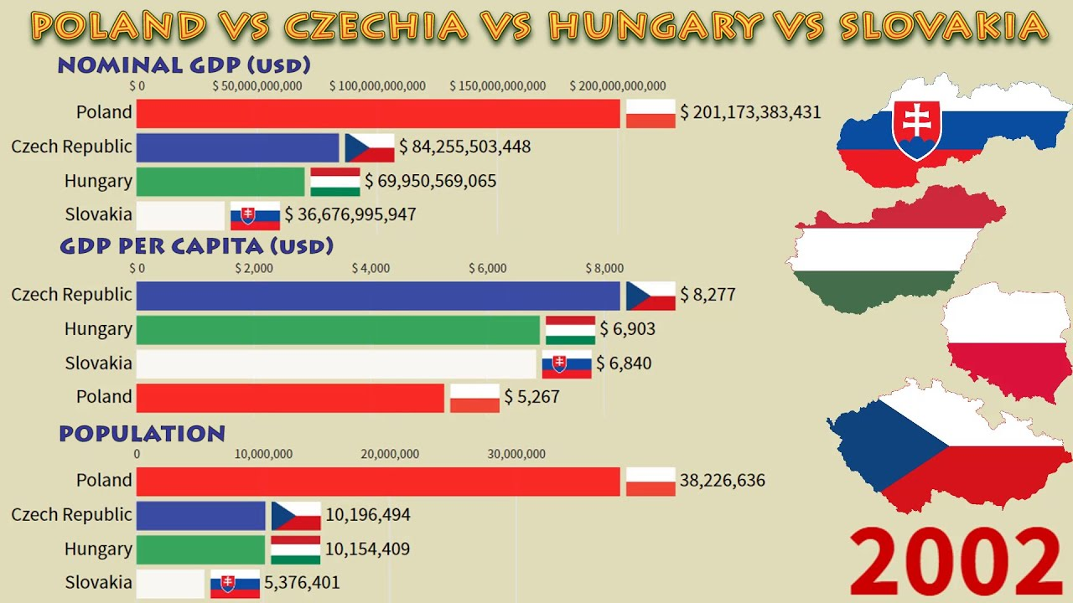

Slide 7
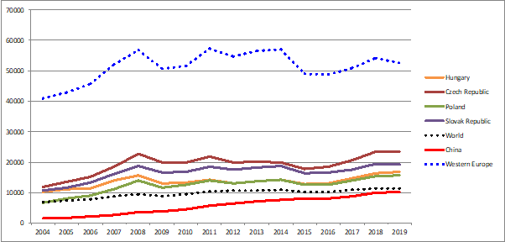
GDP per capita

Slide 8
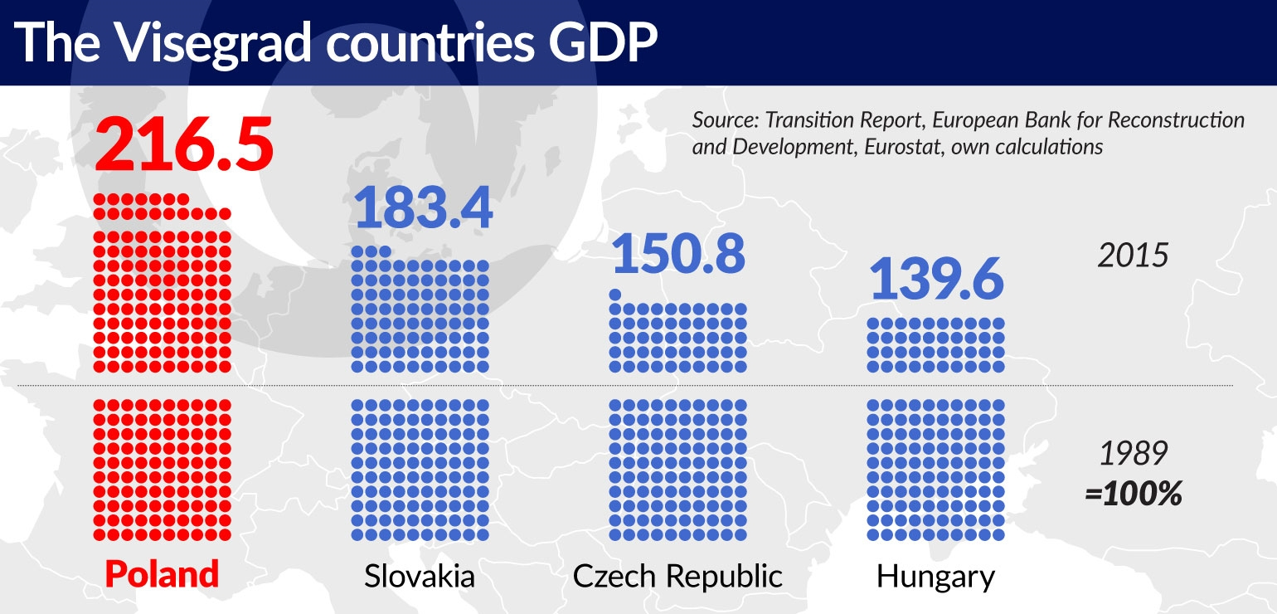

Slide 9
Migration crisis
Hungary on the route through Balkans – affected much more then the rest
The group took a rather resistant stance
Disagreements with some other EU states
Did migration create the real V4 identity within the EU?

Slide 10
NO to Mini-Schengen
During the peak of the migrant crisis some of the EU politicians spoke about the possibility to limit number of Schengen countries
Some spoke about the expulsion of V4
Reason was no solidarity in migration issues
Strong NO from V4

Slide 11
Migration Quotas
Proposed in 2015
Redistribution of some 160.000 asylum seekers
At first opposed by many countries
In the end only 4 voted against – Hungary, Slovakia, Czechia, Romania
ECJ ruled against CZ, PL and HU in 2020
V4 is against Dublin IV – reform of the asylum rules

Slide 12
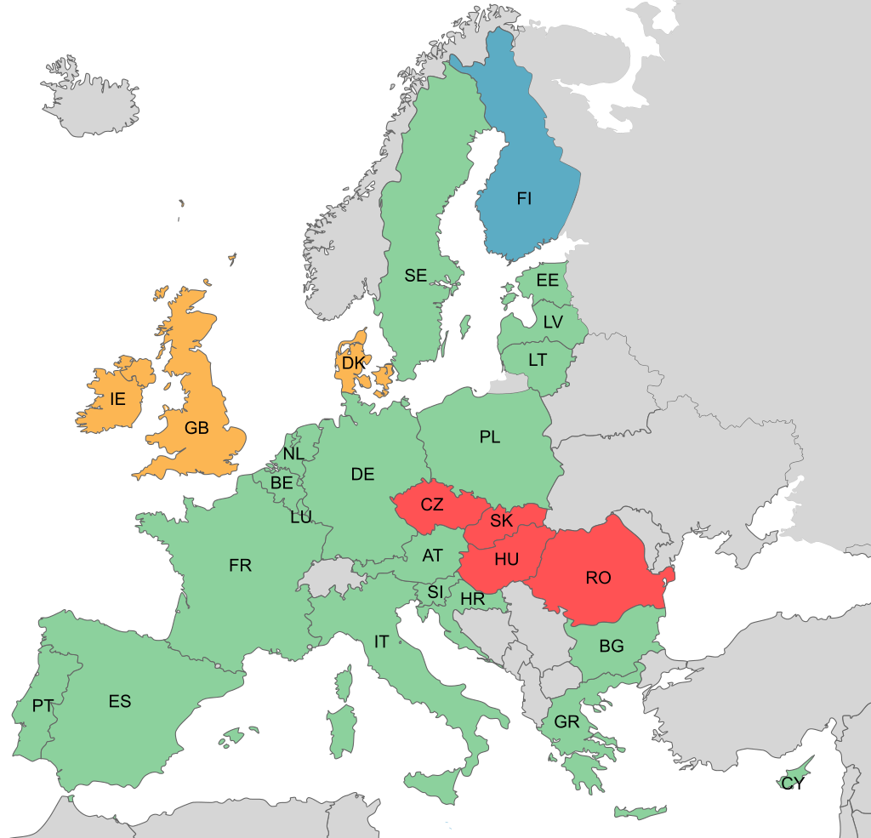

Slide 13
V4 and EU differentiation?
Typical example is the euro-zone
Not all EU countries are members

Slide 14
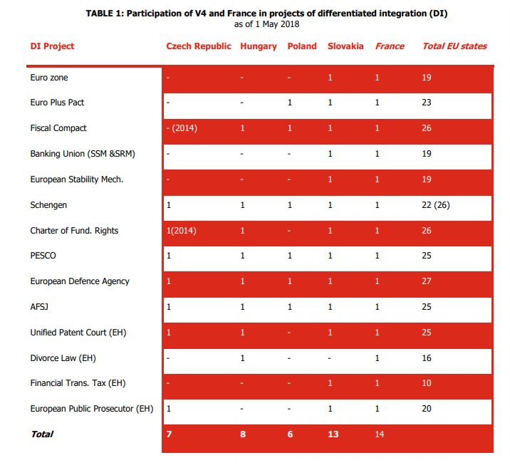

Slide 15
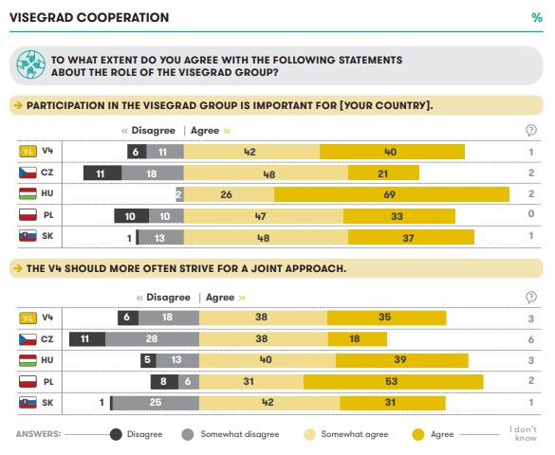

Slide 16
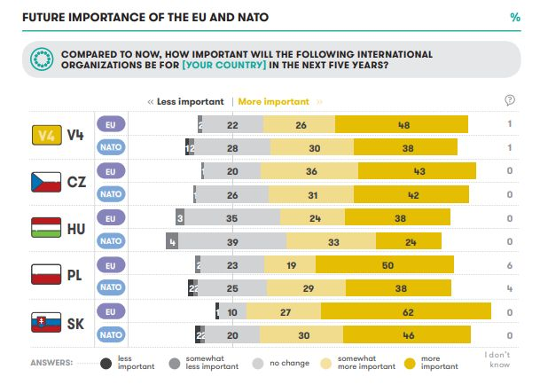

Slide 17
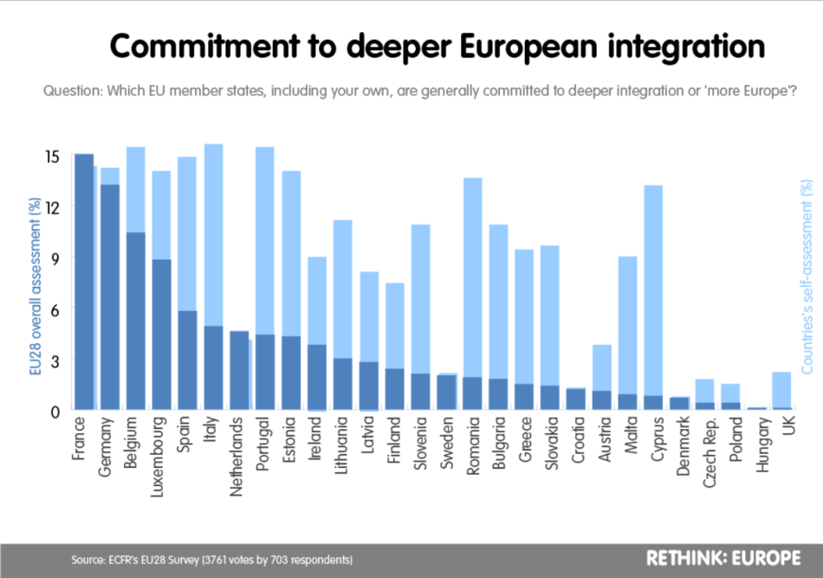

Slide 18
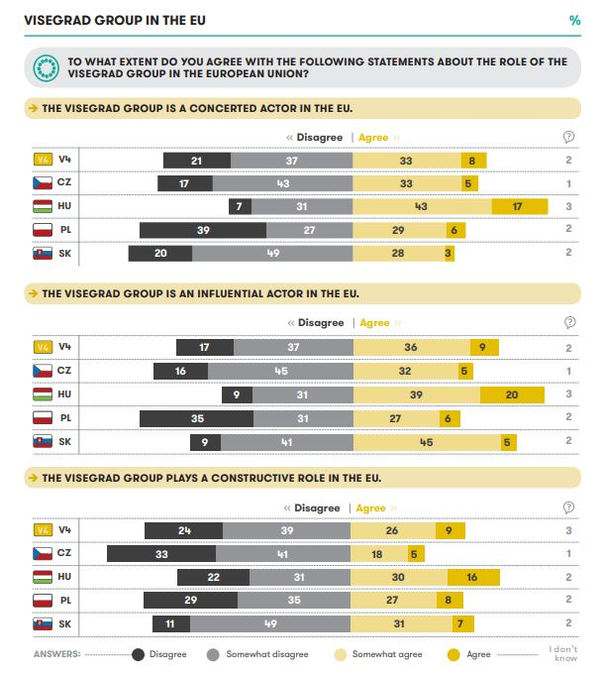

Slide 19
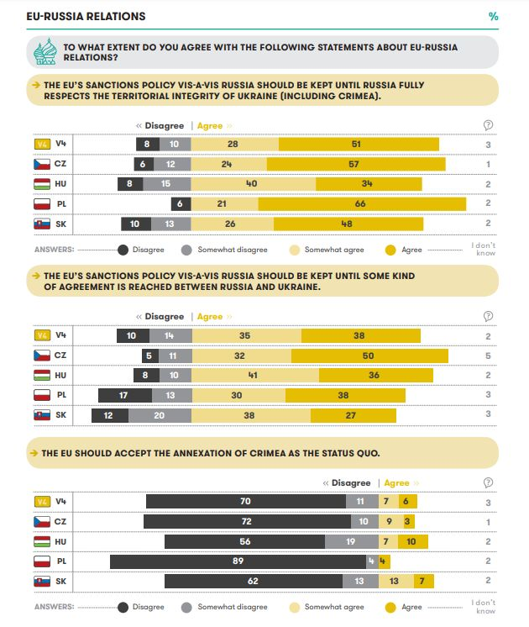

Slide 20
Future?
Currently V4 seems an important platform
The steps are more coordinated than ever before
The reputation within the EU is a bit troublesome

